Slide 1
Chapter 16: Query Optimization

Slide 2
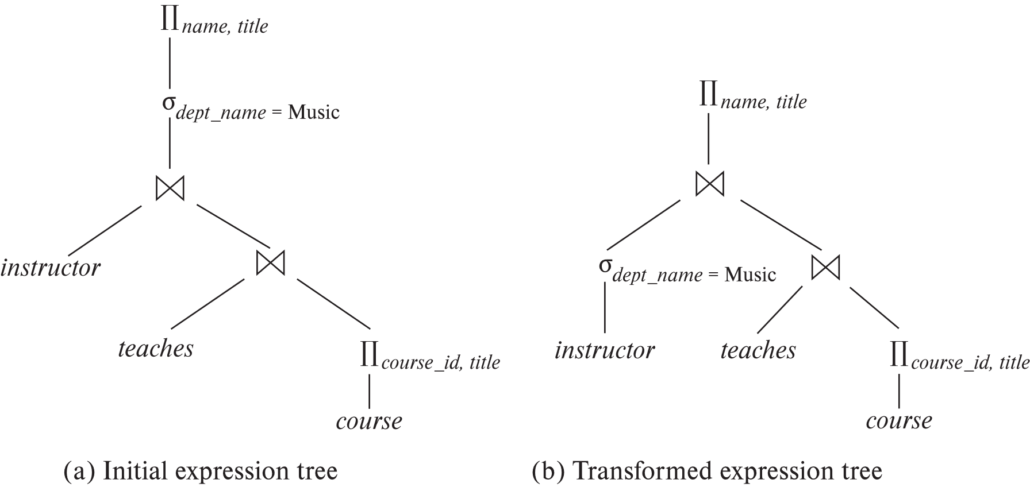
Introduction
List ‘Music’ Dept instructors along with the course titles they are teaching

Slide 3
Introduction
Alternative ways of evaluating a given query
Equivalent expressions
Different algorithms for each operation
List ‘Music’ Dept instructors along with the course titles they are teaching
Cost difference between evaluation plans for a query can be enormous

Slide 4
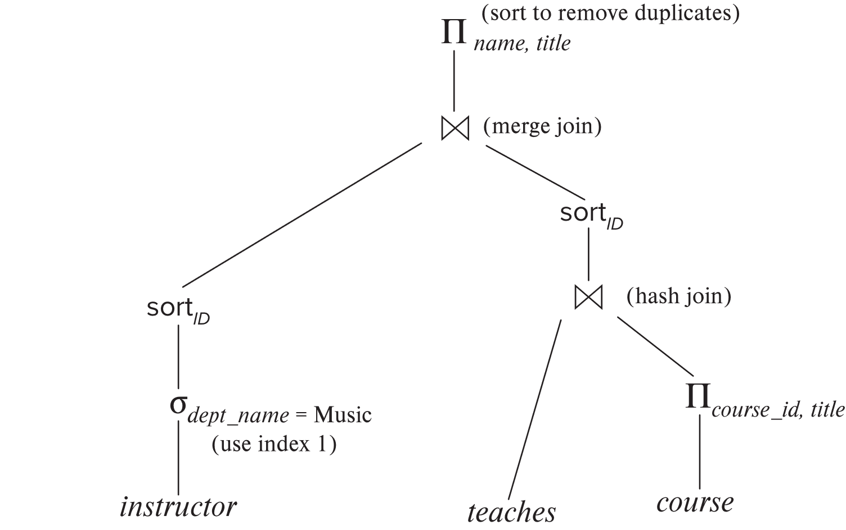
Introduction (Cont.)
An evaluation plan defines exactly what algorithm is used for each operation, and how the execution of the operations is coordinated.

Slide 5
Introduction (Cont.)
Cost difference between evaluation plans for a query can be enormous
E.g., seconds vs. days in some cases
Steps in cost-based query optimization
1. Generate logically equivalent expressions using equivalence rules
2. Annotate resultant expressions to get alternative query plans
3. Choose the cheapest plan based on estimated cost
Estimation of plan cost based on:
Statistical information about relations. Examples:
number of tuples, number of distinct values for an attribute
Statistics estimation for intermediate results
to compute cost of complex expressions
Cost formulae for algorithms, computed using statistics

Slide 6
Viewing Query Evaluation Plans
Most database support explain <query>
Displays plan chosen by query optimizer, along with cost estimates
Some syntax variations between databases
Oracle: explain plan for <query> followed by select * from table (dbms_xplan.display)
SQL Server: set showplan_text on
Some databases (e.g. PostgreSQL) support explain analyse <query>
Shows actual runtime statistics found by running the query, in addition to showing the plan
Find out how to view query execution plans in MySQL????

Slide 7
Generating Equivalent Expressions

Slide 8
Transformation of Relational Expressions
Two relational algebra expressions are said to be equivalent if the two expressions generate the same set of tuples on every legal database instance
Note: order of tuples is irrelevant
we don’t care if they generate different results on databases that violate integrity constraints
In SQL, inputs and outputs are multisets of tuples
Two expressions in the multiset version of the relational algebra are said to be equivalent if the two expressions generate the same multiset of tuples on every legal database instance.
An equivalence rule says that expressions of two forms are equivalent
Can replace expression of first form by second, or vice versa

Slide 9
Equivalence Rules
1. Conjunctive selection operations can be deconstructed into a sequence of individual selections. σ_{θ1 ∧ θ2} (E) ≡ σ_{θ1} (σ_{θ2} (E))
2. Selection operations are commutative. σ_{θ1}(σ_{θ2}(E)) ≡ σ_{θ2} (σ_{θ1}(E))
3. Only the last in a sequence of projection operations is needed, the others can be omitted. ∏ _{L1}(∏ _{L2}(…(∏ _{Ln}(E))…)) ≡ ∏ _{L1}(E) where L₁ ⊆ L₂ … ⊆ L_{n}
4. Selections can be combined with Cartesian products and theta joins.
σ_{θ} (E₁ x E₂) ≡ E₁ ⨝ _{θ} E₂
σ _{θ1} (E₁ ⨝_{θ2} E₂) ≡ E₁ ⨝ _{θ1∧θ2} E₂

Slide 10
Equivalence Rules (Cont.)
5. Theta-join operations (and natural joins) are commutative. E₁ ⨝ E₂ ≡ E₂ ⨝ E₁
6. (a) Natural join operations are associative:
(E₁ ⨝ E₂) ⨝ E₃ ≡ E₁ ⨝ (E₂ ⨝ E₃) (b) Theta joins are associative in the following manner: (E₁ ⨝ _{θ1} E₂) ⨝ _{θ2 ∧ θ3} E₃ ≡ E₁ ⨝_{θ1 ∧ θ3} (E₂ ⨝ _{θ2} E₃) where θ₂ involves attributes from only E₂ and E₃.

Slide 11
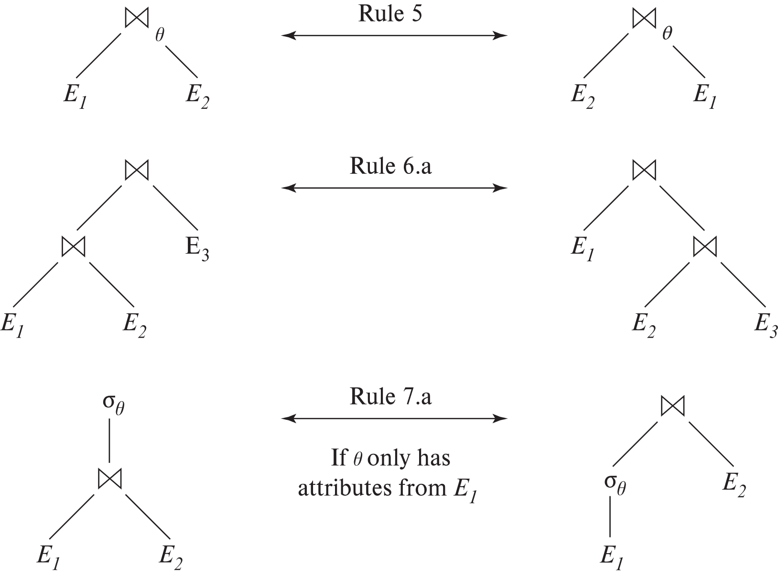
Pictorial Depiction of Equivalence Rules

Slide 12
Equivalence Rules (Cont.)
7. The selection operation distributes over the theta join operation under the following two conditions: (a) When all the attributes in θ₀ involve only the attributes of one of the expressions (E₁) being joined. σ_{θ0} (E₁ ⨝_{θ} E₂) ≡ (σ_{θ0}(E₁)) ⨝_{θ} E₂
(b) When θ₁ involves only the attributes of E₁ and θ₂ involves only the attributes of E₂.
σ_{θ1 ∧ θ2} (E₁ ⨝_{θ} E₂) ≡ (σ_{θ1}(E₁)) ⨝_{θ} (σ_{θ2}(E₂))

Slide 13
Equivalence Rules (Cont.)
8. The projection operation distributes over the theta join operation as follows:
(a) if θ involves only attributes from L₁ ∪ L₂: ∏ _{L1 ∪ L2}(E₁ ⨝_{θ} E₂) ≡ ∏ _{L1}(E₁) ⨝_{θ} ∏ _{L2}(E₂)
(b) In general, consider a join E₁ ⨝_{θ} E₂.
Let L₁ and L₂ be sets of attributes from E₁ and E₂, respectively.
Let L₃ be attributes of E₁ that are involved in join condition θ, but are not in L₁ ∪ L₂, and
let L₄ be attributes of E₂ that are involved in join condition θ, but are not in L₁ ∪ L₂. ∏ _{L1 ∪ L2}(E₁ ⨝_{θ} E₂) ≡ ∏ _{L1 ∪ L2}(∏ _{L1 ∪ L3}(E₁) ⨝_{θ} ∏ _{L2 ∪ L4}(E₂))
Similar equivalences hold for outerjoin operations: ⟕, ⟖, and ⟗

Slide 14
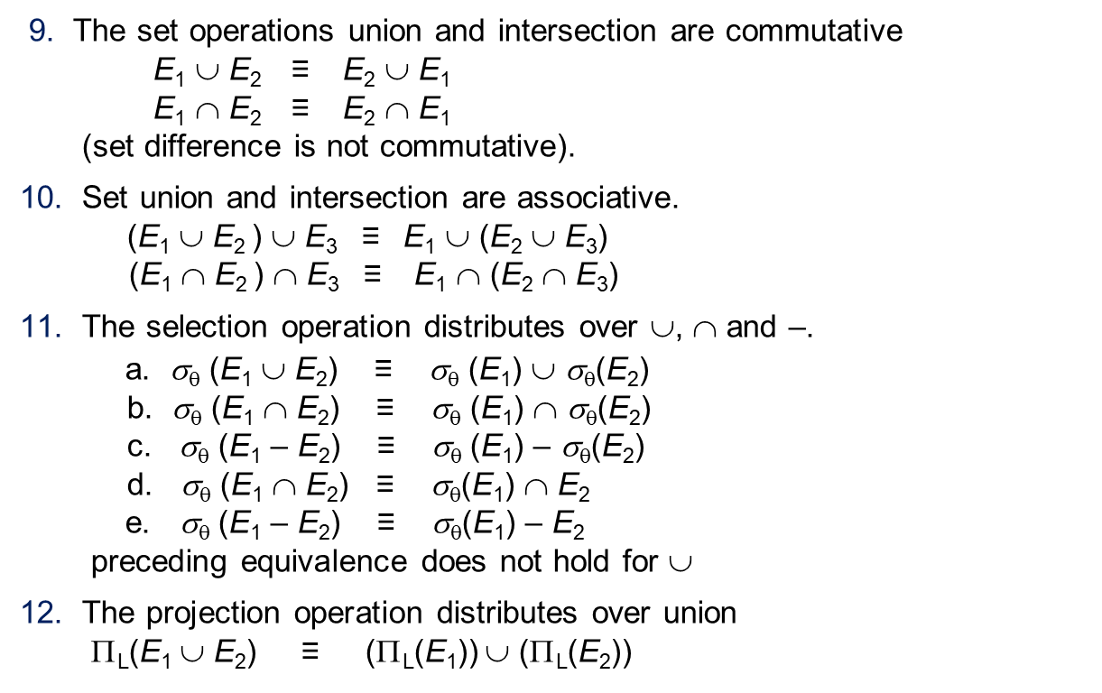
Equivalence Rules (Cont.)
9. The set operations union and intersection are commutative E₁ ∪ E₂ ≡ E₂ ∪ E₁ E₁ ∩ E₂ ≡ E₂ ∩ E₁ (set difference is not commutative).
10. Set union and intersection are associative. (E₁ ∪ E₂ ) ∪ E₃ ≡ E₁ ∪ (E₂ ∪ E₃) (E₁ ∩ E₂ ) ∩ E₃ ≡ E₁ ∩ (E₂ ∩ E₃)
11. The selection operation distributes over ∪, ∩ and –. a. σ_{θ} (E₁ ∪ E₂) ≡ σ_{θ} (E₁) ∪ σ_{θ}(E₂) b. σ_{θ} (E₁ ∩ E₂) ≡ σ_{θ} (E₁) ∩ σ_{θ}(E₂) c. σ_{θ} (E₁ – E₂) ≡ σ_{θ} (E₁) – σ_{θ}(E₂) d. σ_{θ} (E₁ ∩ E₂) ≡ σ_{θ}(E₁) ∩ E₂ e. σ_{θ} (E₁ – E₂) ≡ σ_{θ}(E₁) – E₂ preceding equivalence does not hold for ∪
12. The projection operation distributes over union Π_{L}(E₁ ∪ E₂) ≡ (Π_{L}(E₁)) ∪ (Π_{L}(E₂))

Slide 15
Equivalence Rules (Cont.)
13. Selection distributes over aggregation as below σ_{θ}(_{G}𝛾_{A}(E)) ≡ _{G}𝛾_{A}(σ_{θ}(E)) provided θ only involves attributes in G
14. a. Full outerjoin is commutative: E₁ ⟗ E₂ ≡ E₂ ⟗ E₁ b. Left and right outerjoin are not commutative, but: E₁ ⟕ E₂ ≡ E₂ ⟖ E₁
15. Selection distributes over left and right outerjoins as below, provided θ₁
only involves attributes of E₁ a. σ_{θ1} (E₁ ⟕_{θ} E₂) ≡ (σ_{θ1} (E₁)) ⟕_{θ} E₂ b. σ_{θ1} (E₁ ⟖_{θ} E₂) ≡ E₂ ⟕_{θ} (σ_{θ1} (E₁))
16. Outerjoins can be replaced by inner joins under some conditions
a. σ_{θ1} (E₁ ⟕_{θ} E₂) ≡ σ_{θ1} (E₁ ⨝_{θ} E₂) b. σ_{θ1} (E₁ ⟖_{θ} E₁) ≡ σ_{θ1} (E₁ ⨝_{θ} E₂) provided θ₁ is null rejecting on E₂

Slide 16
Equivalence Rules (Cont.)
Note that several equivalences that hold for joins do not hold for outerjoins
σ_{year=2017}(instructor ⟕ teaches) ≢ σ_{year=2017}(instructor ⨝ teaches)
Outerjoins are not associative (r ⟕ s) ⟕ t ≢ r ⟕ (s ⟕ t)
e.g. with r(A,B) = {(1,1), s(B,C) = { (1,1)}, t(A,C) = { }
Notes:
How about (r ⟕ s) ⟕ t vs (r ⟕ t) ⟕ s assuming r has common attributes with s and t? Hint: consider 2 cases where s and t have common attributes and those where they have no common attribute

Slide 17
Transformation Example: Pushing Selections
Query: Find the names of all instructors in the Music department, along with the titles of the courses that they teach
Π_{name, title}(σ_{dept_name= ‘Music’} (instructor ⨝ (teaches ⨝ Π_{course_id, title} (course))))
Transformation using rule 7a.
Π_{name, title}((σ_{dept_name= ‘Music’}(instructor)) ⨝ (teaches ⨝ Π_{course_id, title} (course)))
Performing the selection as early as possible reduces the size of the relation to be joined.

Slide 18
Example with Multiple Transformations
Query: Find the names of all instructors in the Music department who have taught a course in 2017, along with the titles of the courses that they taught
Π_{name, title}(σ_{dept_name= "Music”∧year = 2017} (instructor ⨝ (teaches ⨝ Π_{course_id, title} (course))))
Transformation using join associatively (Rule 6a):
Π_{name, title}(σ_{dept_name= “Music”∧year = 2017} ((instructor ⨝ teaches) ⨝ Π_{course_id, title} (course)))
Second form provides an opportunity to apply the “perform selections early” rule, resulting in the subexpression
σ_{dept_name = “Music”} (instructor) ⨝ σ _{year = 2017} (teaches)

Slide 19
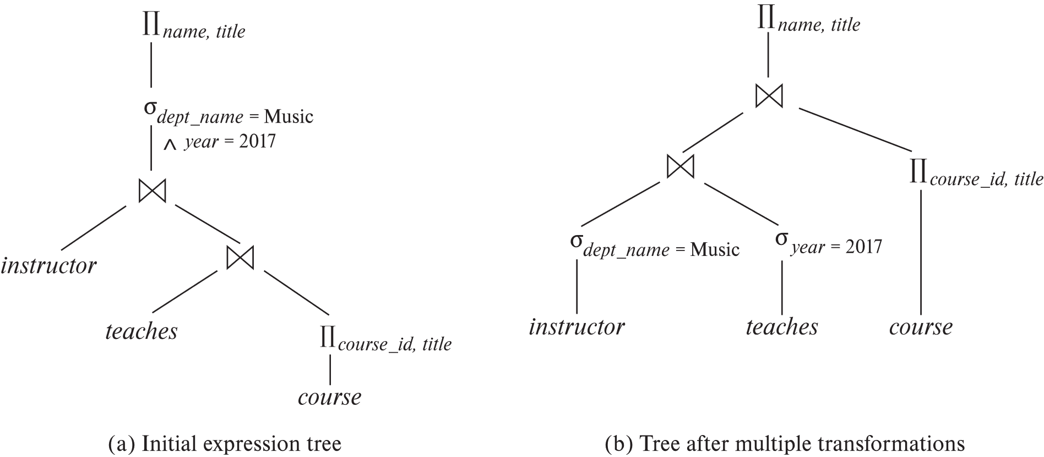
Multiple Transformations (Cont.)

Slide 20
Transformation Example: Pushing Projections
Consider: Π_{name, title}(σ_{dept_name= “Music”} (instructor) ⨝ teaches) ⨝ Π_{course_id, title} (course))))
When we compute
(σ_{dept_name = “Music”} (instructor ⨝ teaches)
we obtain a relation whose schema is: (ID, name, dept_name, salary, course_id, sec_id, semester, year)
Push projections using equivalence rules 8a and 8b; eliminate unneeded attributes from intermediate results to get:
Π_{name, title}(Π_{name, course_id} (σ_{dept_name= “Music”} (instructor) ⨝ teaches) ⨝ Π_{course_id, title} (course))
Performing the projection as early as possible reduces the size of the relation to be joined.

Slide 21
Join Ordering Example
For all relations r_{1,} r_{2,} and r₃,
(r₁ ⨝ r₂) ⨝ r₃ = r₁ ⨝ (r₂ ⨝ r₃ )
If r₂ ⨝ r₃ is quite large and r₁ ⨝ r₂ is small, we choose
(r₁ ⨝ r₂) ⨝ r₃
so that we compute and store a smaller temporary relation.

Slide 22
Join Ordering Example (Cont.)
Consider the expression
Π_{name, title}((σ_{dept_name= “Music”} (instructor) ⨝ teaches) ⨝ Π_{course_id, title} (course))
Could compute teaches ⨝ Π_{course_id, title} (course) first, and join result with σ_{dept_name= “Music”} (instructor) but the result of the first join is likely to be a large relation.
Only a small fraction of the university’s instructors are likely to be from the Music department
it is better to compute
σ_{dept_name= “Music”} (instructor) ⨝ teaches
first.

Slide 23
Enumeration of Equivalent Expressions
Query optimizers use equivalence rules to systematically generate expressions equivalent to the given expression
Can generate all equivalent expressions as follows:
Repeat
apply all applicable equivalence rules on every subexpression of every equivalent expression found so far
add newly generated expressions to the set of equivalent expressions
Until no new equivalent expressions are generated above
The above approach is very expensive in space and time
Space requirements reduced by sharing common sub-expressions
Time requirements are reduced by not generating all expressions (use dynamic programming)
Two approaches
Optimized plan generation based on transformation rules
Special case approach for queries with only selections, projections and joins

Slide 24
Cost-Based Optimization
Consider finding the best join-order for r₁ ⨝ r₂ ⨝ . . . ⨝ r_{n}.
There are (2(n – 1))!/(n – 1)! different join orders for above expression. With n = 7, the number is 665280, with n = 10, the number is greater than 176 billion!
No need to generate all the join orders. Using dynamic programming, the least-cost join order for any subset of {r₁, r₂, . . . r_{n}} is computed only once and stored for future use.

Slide 25
Heuristic Optimization
Cost-based optimization is expensive, even with dynamic programming.
Systems may use heuristics to reduce the number of choices that must be made in a cost-based fashion.
Heuristic optimization transforms the query-tree by using a set of rules that typically (but not in all cases) improve execution performance:
Perform selection early (reduces the number of tuples)
Perform projection early (reduces the number of attributes)
Perform most restrictive selection and join operations (i.e., with smallest result size) before other similar operations.
Some systems use only heuristics, others combine heuristics with partial cost-based optimization.

Slide 26
Statistics for Cost Estimation

Slide 27
Statistical Information for Cost Estimation
n_{r}: number of tuples in a relation r.
b_{r}: number of blocks containing tuples of r.
l_{r}: size of a tuple of r.
f_{r}: blocking factor of r — i.e., the number of tuples of r that fit into one block.
V(A, r): number of distinct values that appear in r for attribute A; same as the size of ∏_{A}(r).
If tuples of r are stored together physically in a file, then:

Slide 28
Histograms
Histogram on attribute age of relation person
Equi-width histograms
Equi-depth histograms break up range such that each range has (approximately) the same number of tuples
Many databases also store n most-frequent values and their counts
Histogram is built on remaining values only
Histograms and other statistics usually computed based on a random sample
Statistics may be out of date
Some database require an ‘analyse' command to be executed to update statistics
Others automatically re-compute statistics
e.g., when number of tuples in a relation changes by some percentage

Slide 29
Selection Size Estimation
σ_{A=v}(r)
n_{r} / V(A,r) : number of records that will satisfy the selection
Equality condition on a key attribute: size estimate = 1
σ_{A≤V}(r) (case of σ_{A ≥ V}(r) is symmetric)
Let c denote the estimated number of tuples satisfying the condition.
If min(A,r) and max(A,r) are available in catalog
c = 0 if v < min(A,r)
c =
If histograms available, can refine above estimate
In absence of statistical information c is assumed to be n_{r} / 2.

Slide 30
Size Estimation of Complex Selections
The selectivity of a condition θ_{i} is the probability that a tuple in the relation r satisfies θ_{i} .
If s_{i} is the number of satisfying tuples in r, the selectivity of θ_{i} is given by s_{i} /n_{r}.
Conjunction: σ_{θ1∧ θ2∧. . . ∧ θn} (r). Assuming independence, estimate of tuples in the result is:
Disjunction:σ_{θ1∨} _{θ2 ∨. . . ∨} _{θn} (r). Estimated number of tuples:
Negation: σ_{¬θ}(r). Estimated number of tuples: n_{r} – size(σ_{θ}(r))

Slide 31
Join Operation: Running Example
Running example: student ⨝ takes
Catalog information for join examples:
n_{student} = 5,000.
f_{student} = 50, which implies that b_{student} =5000/50 = 100.
n_{takes} = 10000.
f_{takes} = 25, which implies that b_{takes} = 10000/25 = 400.
V(ID, takes) = 2500, which implies that on average, each student who has taken a course has taken 4 courses.
Attribute ID in takes is a foreign key referencing student.
V(ID, student) = 5000 (primary key!)

Slide 32
Estimation of the Size of Joins
The Cartesian product r x s contains n_{r} .n_{s} tuples; each tuple occupies s_{r} + s_{s} bytes.
If R ∩ S = ∅, then r ⋈ s is the same as r x s.
If R ∩ S is a key for R, then a tuple of s will join with at most one tuple from r
therefore, the number of tuples in r ⋈ s is no greater than the number of tuples in s.
If R ∩ S in S is a foreign key in S referencing R, then the number of tuples in r ⋈ s is exactly the same as the number of tuples in s.
The case for R ∩ S being a foreign key referencing S is symmetric.
In the example query student ⋈ takes, ID in takes is a foreign key referencing student
hence, the result has exactly n_{takes} tuples, which is 10000

Slide 33
Estimation of the Size of Joins (Cont.)
If R ∩ S = {A} is not a key for R or S. If we assume that every tuple t in R produces tuples in R S, the number of tuples in R ⨝ S is estimated to be: If the reverse is true, the estimate obtained will be: The lower of these two estimates is probably the more accurate one.
Can improve on above if histograms are available
Use formula similar to above, for each cell of histograms on the two relations

Slide 34
Estimation of the Size of Joins (Cont.)
Compute the size estimates for student ⨝ takes without using information about foreign keys:
n_{student} = 5,000.
n_{takes} = 10000.
V(ID, takes) = 2500, and V(ID, student) = 5000
The two estimates are 5000 * 10000/2500 = 20,000 and 5000 * 10000/5000 = 10000
We choose the lower estimate, which in this case, is the same as our earlier computation using foreign keys.

Slide 35
Size Estimation for Other Operations
Projection: estimated size of ∏_{A}(r) = V(A,r)
Aggregation : estimated size of _{G}𝛾_{A}(r) = V(G,r)
Set operations
For unions/intersections of selections on the same relation: rewrite and use size estimate for selections
E.g., σ_{θ1} (r) ∪ σ_{θ2} (r) can be rewritten as σ_{θ1 or θ2} (r)
For operations on different relations:
estimated size of r ∪ s = size of r + size of s.
estimated size of r ∩ s = minimum size of r and size of s.
estimated size of r – s = r.
All the three estimates may be quite inaccurate, but provide upper bounds on the sizes.
Outer join:
Estimated size of r ⟕ s = size of r ⨝ s + size of r
Case of right outer join is symmetric
Estimated size of r ⟗ s = size of r ⨝ s + size of r + size of s

Slide 36
Query Optimization and Materialized Views
Rewriting queries to use materialized views:
A materialized view v = r ⨝ s is available
A user submits a query r ⨝ s ⨝ t
We can rewrite the query as v ⨝ t
Whether to do so depends on cost estimates for the two alternative
Replacing a use of a materialized view by the view definition:
A materialized view v = r ⨝ s is available, but without any index on it
User submits a query σ_{A=10}(v).
Suppose also that s has an index on the common attribute B, and r has an index on attribute A.
The best plan for this query may be to replace v by r ⨝ s, which can lead to the query plan σ_{A=10}(r) ⨝ s
Query optimizer considers these alternatives and choose the best overall plan.

Slide 37
Materialized View Selection
Materialized view selection: “What is the best set of views to materialize?”
Index selection: “what is the best set of indices to create”
closely related, to materialized view selection
but simpler
Materialized view selection and index selection based on typical system workload (queries and updates)
Typical goal: minimize time to execute workload, subject to constraints on space and time taken for some critical queries/updates
One of the steps in database tuning
Commercial database systems provide tools (called “tuning assistants” or “wizards”) to help the database administrator choose what indices and materialized views to create

Slide 38
Multiquery Optimization
Example
Q1: select * from (r natural join t) natural join s
Q2: select * from (r natural join u) natural join s
Both queries share common subexpression (r natural join s)
May be useful to compute (r natural join s) once and use it in both queries
But this may be more expensive in some situations
e.g. (r natural join s) may be expensive, plans as shown in queries may be cheaper
Multiquery optimization: find best overall plan for a set of queries, expoiting sharing of common subexpressions between queries where it is useful

Slide 39
Multiquery Optimization (Cont.)
Simple heuristic used in some database systems:
optimize each query separately
detect and exploiting common subexpressions in the individual optimal query plans
May not always give best plan, but is cheap to implement
Shared scans: widely used special case of multiquery optimization
Set of materialized views may share common subexpressions
As a result, view maintenance plans may share subexpressions
Multiquery optimization can be useful in such situations
Notes:
39

Slide 40
Parametric Query Optimization
Example select * from r natural join s where r.a < $1
value of parameter $1 not known at compile time
known only at run time
different plans may be optimal for different values of $1
Solution 1: optimize at run time, each time query is submitted
can be expensive
Solution 2: Parametric Query Optimization:
optimizer generates a set of plans, optimal for different values of $1
Set of optimal plans usually small for 1 to 3 parameters
Key issue: how to do find set of optimal plans efficiently
best one from this set is chosen at run time when $1 is known
Solution 3: Query Plan Caching
If optimizer decides that same plan is likely to be optimal for all parameter values, it caches plan and reuses it, else reoptimize each time
Implemented in many database systems

Slide 41
Adaptive Query Processing
Some systems support adaptive operators that change execution algorithm on the fly
E.g., (indexed) nested loops join or hash join chosen at run time, depending on size of outer input
Other systems allow monitoring of behavior of plan at run time and adapt plan
E.g., if statistics such as number of rows is found to be very different in reality from what optimizer estimated
Can stop execution, compute fresh plan, and restart
But must avoid too many such restarts

Slide 42
End of Chapter

